Slide 1

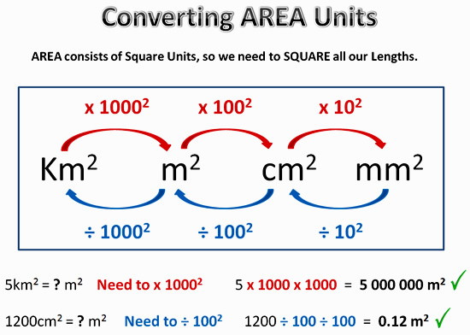
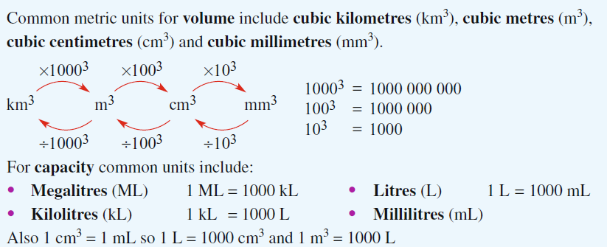
My Measurement Interactive Notebook
Name
Class
Teacher
Term
1

Slide 2
Contents
Glossary or Formula Page
Page
Date
Description
2
3

Slide 3
Tasks
24
7
30
Essential Question
Questions
Notes
Summary
6
7

Slide 4
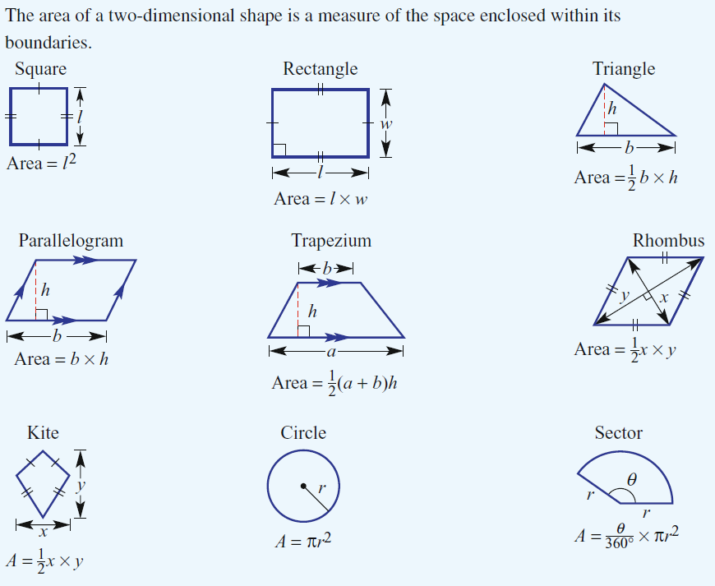
24
7
30
Date
Area and then Volume Revision
EQ – Describe how to find the area of different shapes.
How do we find the area of 2 dimensional shapes?
5

Slide 5
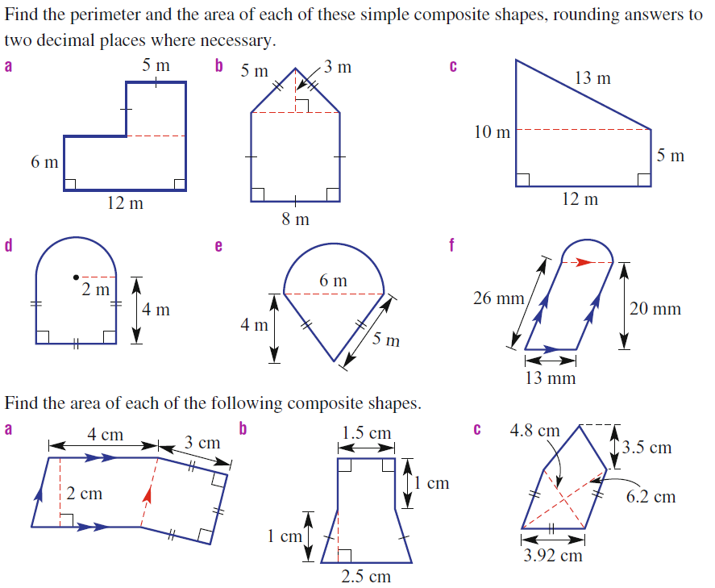
Questions

Slide 6
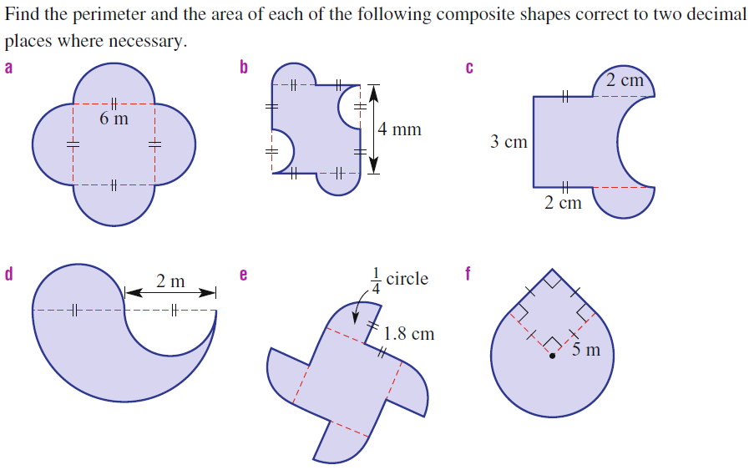
Questions

Slide 7
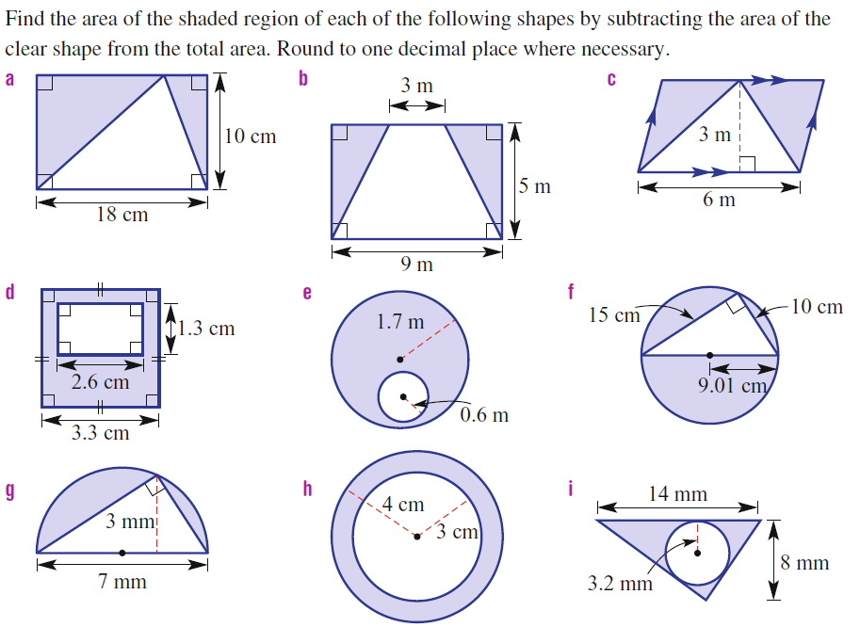
Answers

Slide 8
24
7
30
Date
Area and then Volume Revision
EQ – Describe how to find the area of different shapes.
How do we find the area of 2 dimensional shapes?
Do exercise 3.1 page 34 Dwyer book
5

Slide 9
24
7
30
Date
Area and now Volume Revision
EQ – Describe how to find the Volume of different shapes.
How do we find the volume of 3 dimensional shapes?
Summary of formulae in this section
Shape | Volume Formula
All prisms Rectangular Prism Triangular Prism Trapezoidal prism Cylinder Cube | Volume = Area of Base × Perp Ht (or Depth) For a rectangular prism, V = LBH For a cube, V = S³ For a triangular prism, V = ½ B ht Depth For a cylinder, V = πr²h
All volumes are in cubic units – m³. cm³, mm³
Because Volume is 3 – DIMENSIONAL!
5

Slide 10
24
7
30
Date
Area and now Volume Revision
EQ – Describe how to find the Volume of different shapes.
How do we find the volume of 3 dimensional shapes?
Height
Height
These are all prisms…..
Check out the base and height of each.
Base can be any face.
Base
Base
Height
5

Slide 11

24
7
30
Date
Area and now Volume Revision
EQ – Describe how to find the Volume of different shapes.
3m
How do we find the volume of 3 dimensional shapes?
5m
4m
5m
7m
12m
Vol = Base Area × Perp Ht
= 5 x 4 x 3
= 60 m³
NOTE!! The base is the Δ front and height is 7
Vol = Base Area × Perp Ht
= (½ × 12 × 5) × 7
= 210 m³
5cm
8cm
9cm
Note! r = 2cm
12cm
5cm
4cm
Note! Base is front trapezium & height is 12
Vol = Base Area × Perp Ht
= π × 2² × 5
= 62.83 cm³
Vol = Base Area × Perp Ht
= 672 cm³
5

Slide 12
24
7
30
Date
Area and now Volume Revision
EQ – Describe how to find the Volume of different shapes.
How do we find the volume of 3 dimensional shapes?
Do exercise 3.2 page 35 Dwyer book
5

Slide 13
Notes Review
24, 7 ,30
Date
Title
Essential question
Notes complete
Notes complete with colour and diagrams
Questions completed
Contents page filed in
Formula page filled in

Slide 14
Homework
Review your notes and write a summary answering the essential question.

